Slide 1

Predicting the Popular Areas
By: Shilpi

Slide 2
Improve the experience of the visitors
Visitors like to experience the place and visit the most popular areas and locations.
If visitors know about the areas in town which has most number of popular places beforehand, then it will certainly help them to plan the trip better.
Getting different attractions in the vicinity will certainly reduce the travel time.
Visitor can see more iconic venues with less travel time.
Prediction will help the visitors in saving the money:
By booking their reservations in advance at the local landmark places like restaurants, museums etc.
By booking their accommodation, rent the car, etc. based on the travel time required to reach these highly rated places of the city.

Slide 3
Data acquisition and cleaning
Foursquare API has information about the venues and their categories for Orlando, Florida.
While retrieving only the popular venues from Foursquare API, an additional parameter is used(bool_popular = 1).
Geolocation data (latitude and longitude) is retrieved from Google Maps API.
There are 61 categories for venues in the dataset retrieved from Foursquare API.
The cleaned data contains four major categories (Restaurant, Drinks, Park, Others).

Slide 4
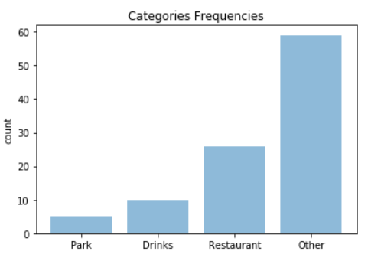
Analysis: Frequency of venues in different categories
hhhhh
This tells that there are 6 popular parks, 10 popular locations to enjoy the
Drinks and 30 highly rated restaurants.

Slide 5
Analysis: Listing Top 5 venues in different categories based on the frequencies calculated
Parks
Lake Underhill Park
Lake Eola Park
Lake Davis Park
Delaney Park
Orlando Loch Haven Park
Restaurants
Tijuana Flats
Chipotle Mexican Grill
Chick-fil-A
Gringos Locos
Firebirds Wood Fired Grill
Drinks
Lucky Lure
The Hammered Lamb
Southern Nights
Roque Pub
Stonewall
Others
Publix
Wawa
ABC Fine Wine & Spirits
Starbucks
The Country Club Of Orlando

Slide 6
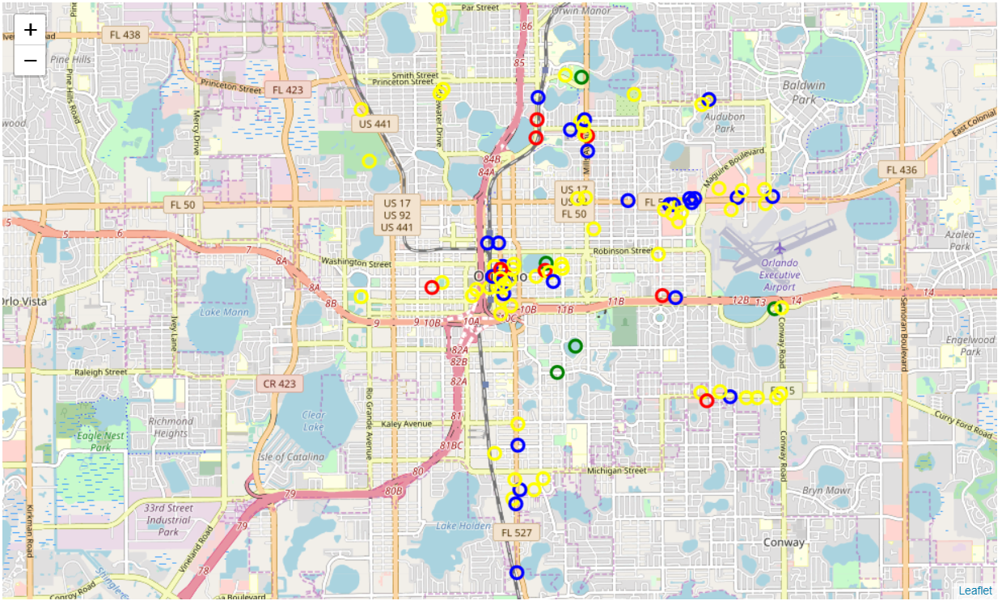
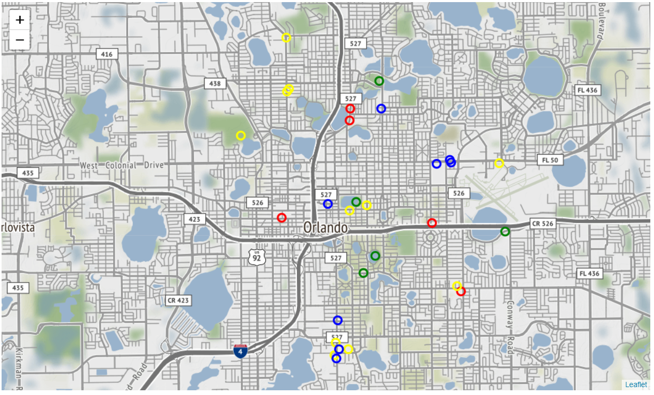
Analysis: Geolocation of the popular venues
This graphs shows all the popular venues in four different categories.
This graph shows the top 5 venues in the four different categories.
Markers color codes are: Drinks-Red, Restaurant-Blue, Park-green, Others-yellow

Slide 7
Conclusion
This will help visitors to narrow down the area and places based on their interest.
Adding this functionality to the application will be useful for the application users.
This will help users to make the informed decision.
In return application/website will be get good traffic which will help in revenue generation.

